Slide 1
SC DHEC: 303d List of Impaired Waters
Levi mckercher
Msci 758 Hack-a-thon
January 28, 2022

Slide 2
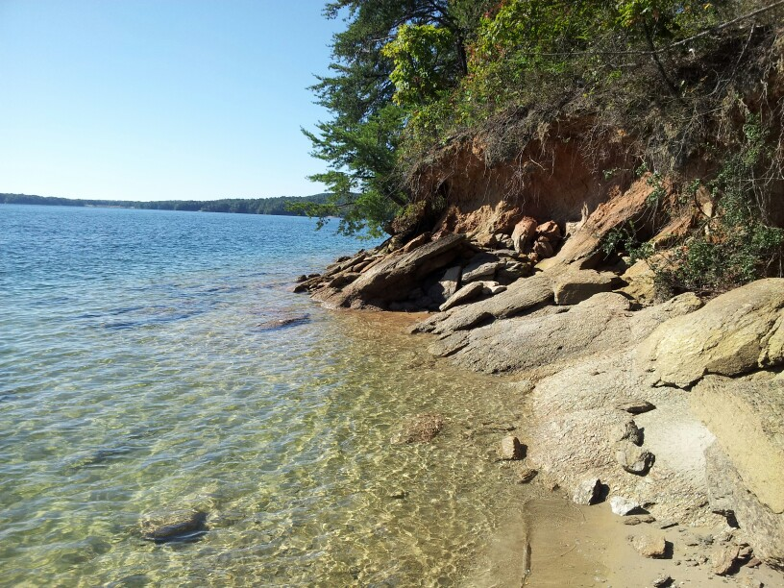
Lake Jocassee, SC, USA
https://southcarolinalakes.info/largest-lakes/lake-jocassee-south-carolina.html

Slide 3
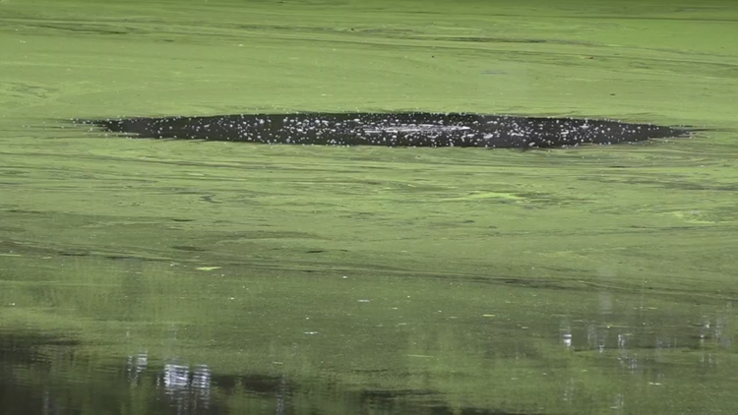
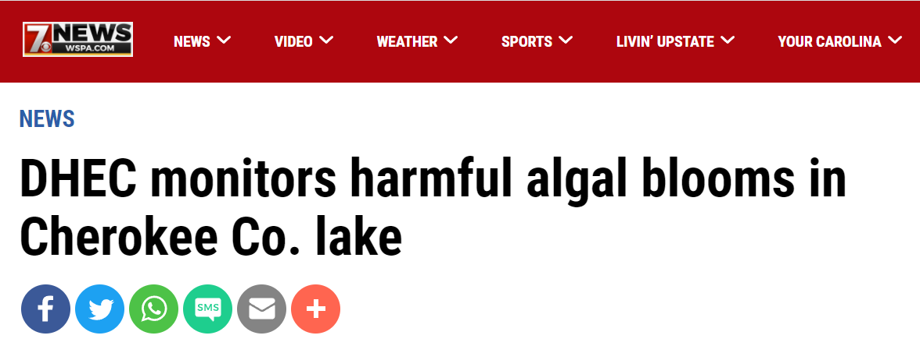
Lake Whelchel,
SC, USA
https://www.wltx.com/article/news/health/harmful-algal-bloom-found-in-lake-whelchel-recreational-advisory-in-place-south-carolina/101-1a1590bc-7376-4e16-b8b0-e9a81c94d2f1

Slide 4
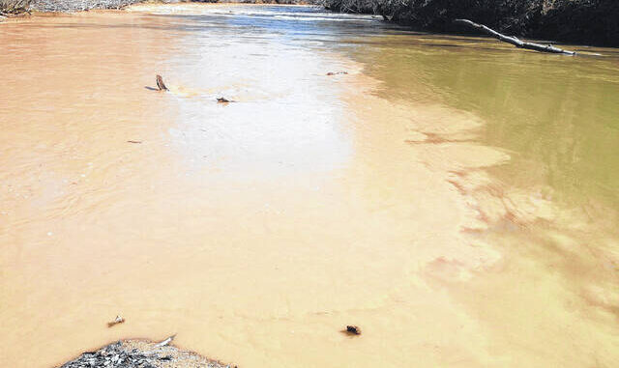
Upper Saluda Rivers near drainage point at Lake Saluda, SC, USA
How does the United States identify and manage waterbodies with poor or impaired water quality?
303d List of Impaired Waters
https://www.sentinelprogress.com/top-stories/15901/save-our-saluda-awarded-second-319-grant

Slide 5
What is the 303d List of Impaired Waters?
Clean Water Act (Section 319) requires all states to identify impaired freshwater bodies that do NOT meet state water quality standards
EPA is the regulatory agency
SC DHEC compiles the list and produces the report
303d List of Impaired Waters
Report created every two years (1998, 2000, …, 2018)
Large open-access datasets in PDF and Excel file types

Slide 6
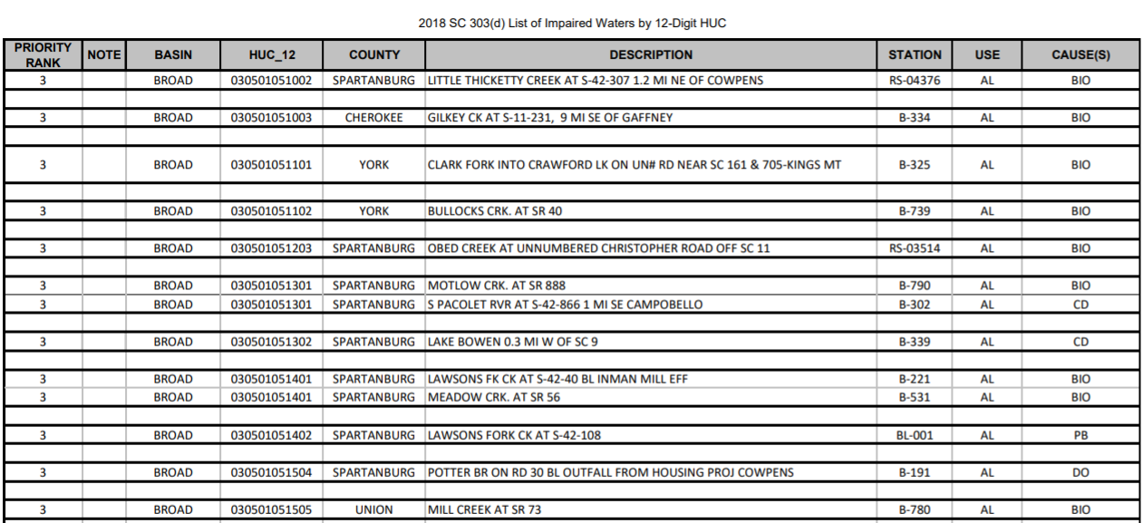
Total # Waterbody Impairments on 2018 List = ???
1,238

Slide 7
Uses
Causes
Aquatic Life Use AL
Fish Consumption FISH
Recreational Use (Swim) REC
Shellfish Harvesting SHELLFISH
Total Nitrogen TN
Chlorophyll A CHLA
Turbidity TURBIDITY
Mercury HG
Copper CU
Dissolved Oxygen DO
Fecal Coliform Bacteria FC
Macroinvertebrate BIO
Many More……

Slide 8
Priority Rank (1-3)
1. Current Priorities: are those site/pollutant combinations being addressed by TMDL or alternative restoration plans during previous two-year term
2. Near-Term Priorities: are those site/pollutant combinations being addressed by TMDL or alternative restoration plans being developed during the next two-year term
3. Long-Term Priorities: are those site/pollutant combinations being addressed by TMDL or alternative restoration plans being developed after next two-year term

Slide 9
Delisting from 303d List of Impaired Waters
Three potential pathways for “delisting”:
1. SC water quality standard is met
2. There was a listing error
3. A total maximum daily load (TMDL) has been calculated and approved by EPA*

Slide 10
Total Maximum Daily Load (TMDL)
Definition: the maximum amount of a pollutant (from point and nonpoint sources) that a waterbody can receive while still meeting water quality standards.
TMDL => Implementation Plan => Waterbody Restoration
*If a TMDL is calculated and approved by US EPA, the waterbody can be removed from 303d list without meeting SC water quality standards*

Slide 11
Potential Questions?
Is overall waterbody impairment increasing or decreasing over time from 1998 – 2018?
What areas of the state (counties) are most susceptible to waterbody impairment?
What waterbody use is most threated by waterbody impairment?
What is the most frequent cause of waterbody impairment?
- Provide potential suggestions for restoration?
What are the trends for each waterbody impairment cause over time?
Are high priority waterbodies being removed from the list? Any reoccurrence?

Slide 12
References
US EPA
https://www.epa.gov/tmdl/overview-listing-impaired-waters-under-cwa-section-303d
SC DHEC
https://scdhec.gov/bow/south-carolina-303d-list-impaired-waters-tmdls

